Slide 1

A Web Application for Student Internship Management using Spring Boot Framework
Author- Usha Yampati
Advisor- Dr Karen Jin
Date: December 10, 2020

Slide 2
Objectives
The Primary goal of this project is to provide a platform for the admin to view and manage the data through a Dashboard built-in website, which helps perform CRUD operations on Data through a UI. Also, integrated Google maps API to display the student's Internship workplace location on the portal Dashboard.
Import the data from the excel sheet to the database and develop the back-end database which is student info model.
Have back-end APIs to the database built.
Perform CRUD operations to the APIs built from the front end integrating it with the back-end.
Get the location of the internship of workplace of the student.
Implement Search Functionality based on Student Name and Major

Slide 3
Approach
Tools and Frameworks
Spring Boot Framework
REST API
REACT JS
NODE JS
BOOTSTRAP
POSTGRES NOSQL
Database:
I have created a schema in postgres and then I have loaded the data in NOSQL Database
I used Spring Boot MVC controller, which will start-up an embedded Apache Tomcat server by default.

Slide 4
Approach Continuation
ReactJS:
For the front-end application I have used ReactJS.
I developed component for dashboard to display the list of the data we have in the database as the home page for my application
Implemented the CRUD operations from this component to the backend data base which allows to Create, Read, Delete and Update the students details.
After CRUD operations being developed, I integrated the Google maps location API with my react application to get the location of the workplace of students
Later, created an endpoint for search functionality and integrated it with my front end react application.

Slide 5
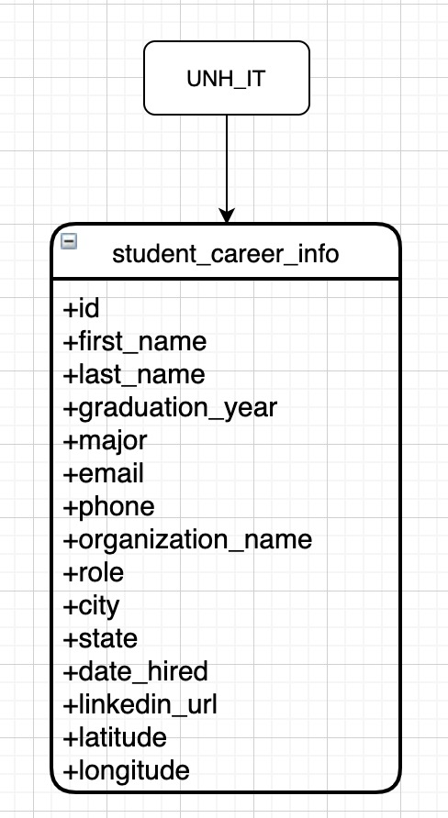
Results
Data schema diagram which has the data fields in the data model to access from the front-end application
Backend database server which has the data being uploaded from the excel sheet by importing it
Spring boot application with API endpoints for the resource and the search endpoint
NodeJS as middleware to run the http requests on to the Database from the spring boot application
Postman for testing backend API

Slide 6
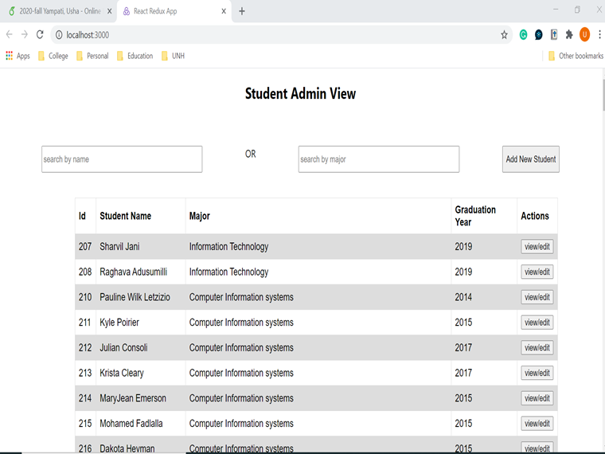
Results
Front end ReactJS application with all the CRUD operations working on to the backend database.
Search functionality to search by student name or by major.
Google map integration which shows the pinned location of the workplace of student

Slide 7
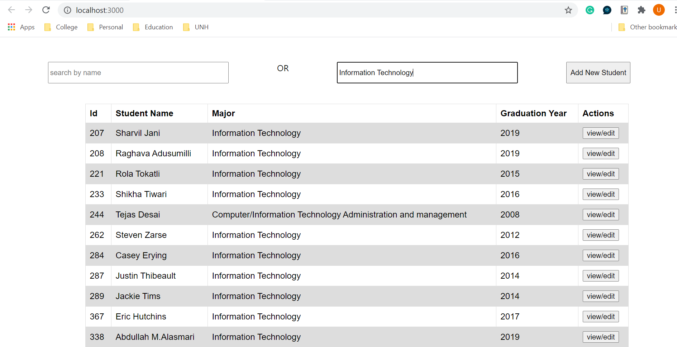
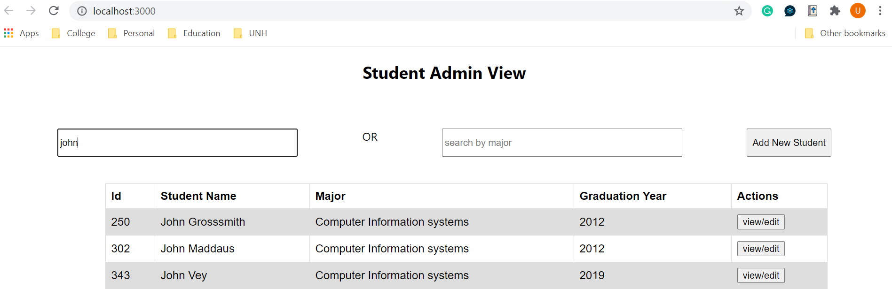
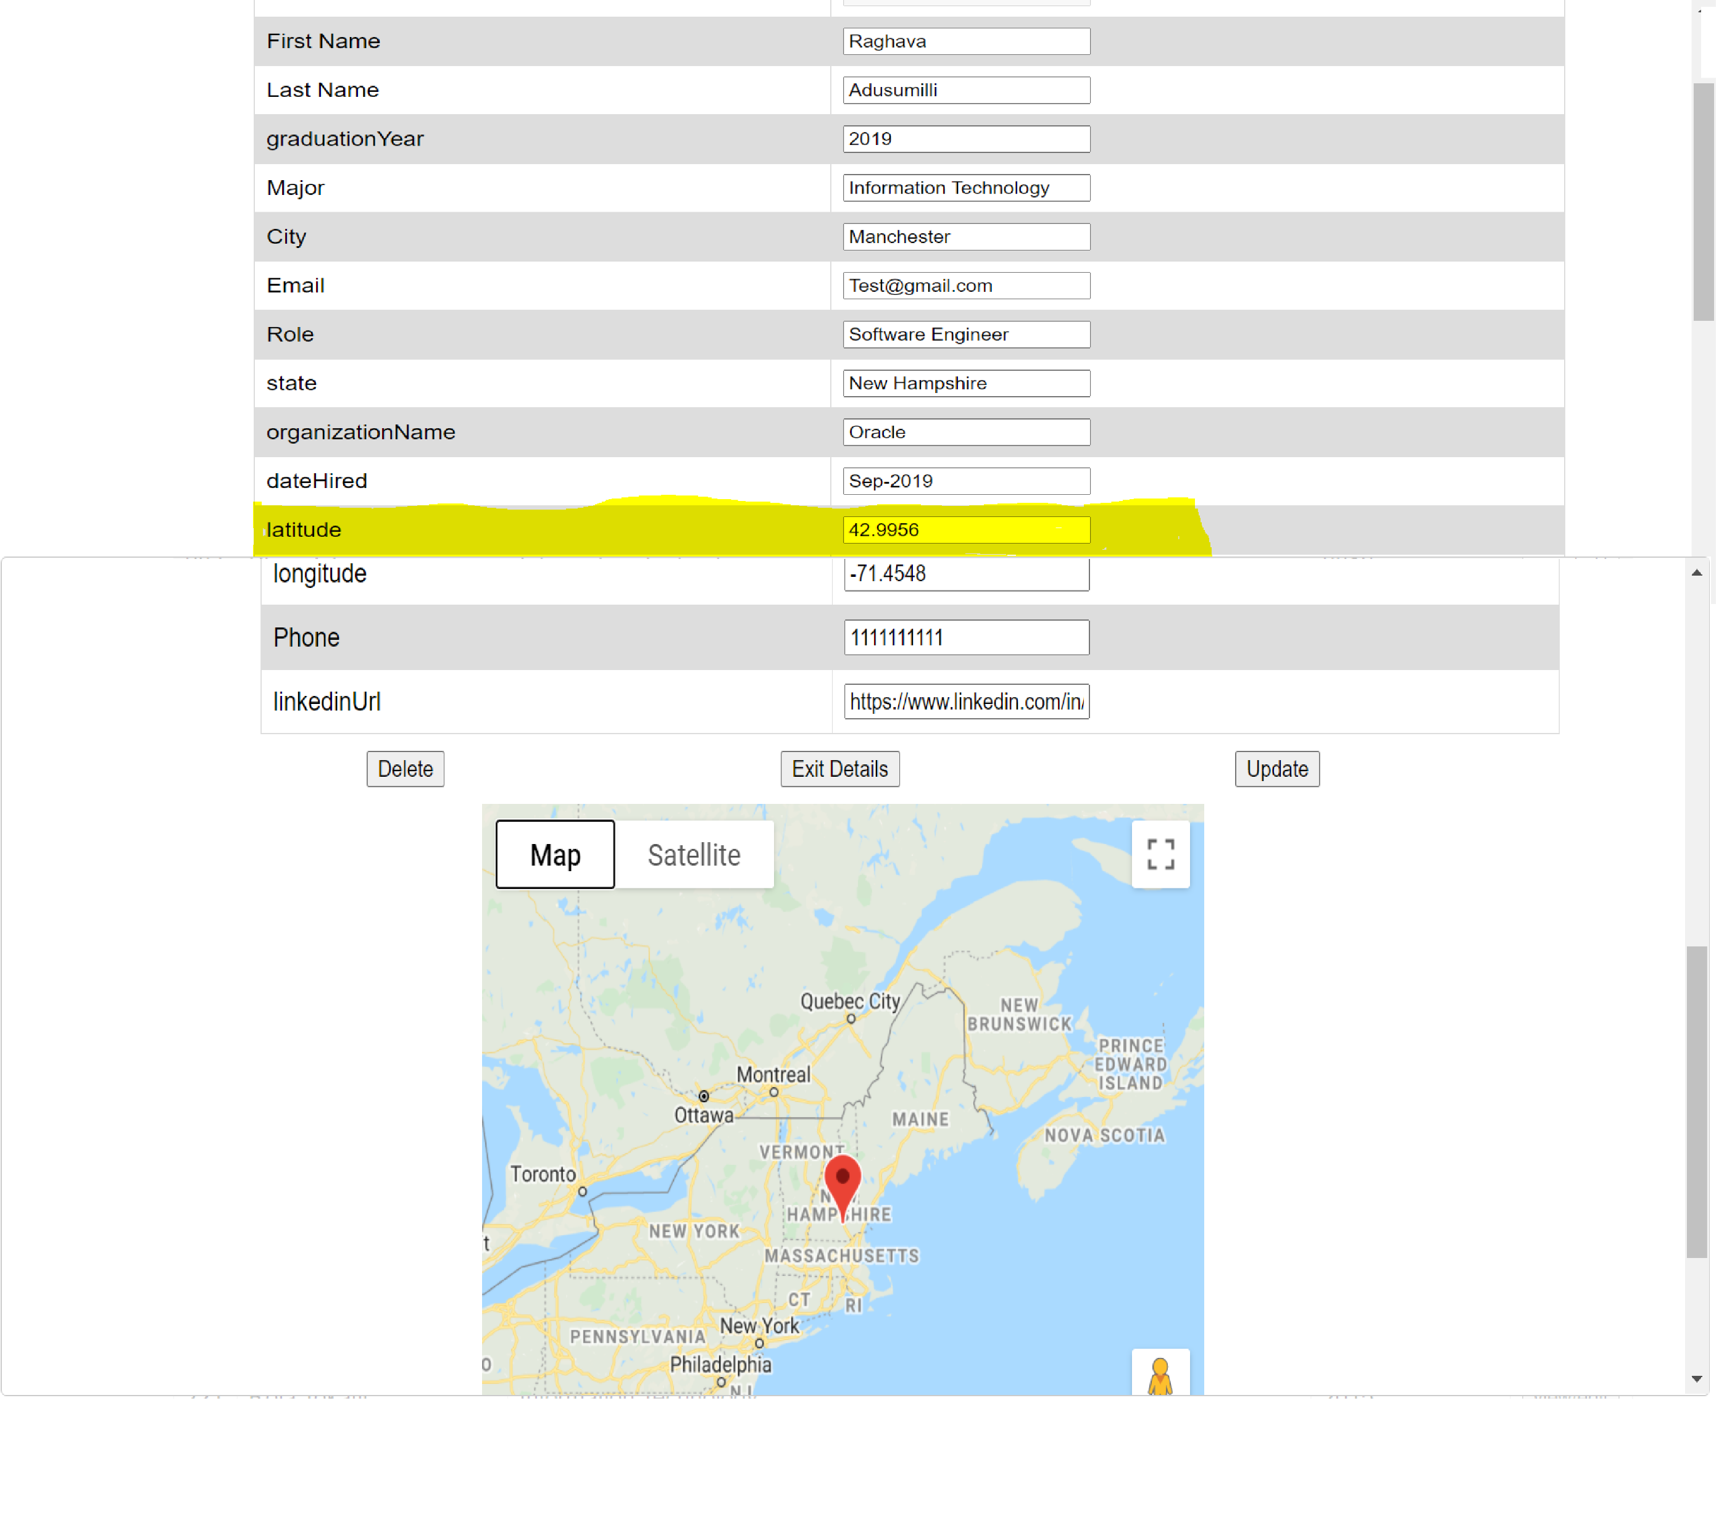
Results

Slide 8
Evaluation
Have spring boot application with the CRUD operations working as developed on to the NoSQL Postgres database
Have front end react application which can access and manipulate the data in the backend
Have Google API to show the location of the company
Had the backend API working with the mock data when tested using Postman. But when I imported the data from the excel sheet and tested the Add functionality started throwing errors and must resolve that.

